Slide 1
Routing, Http Interaction, Testing and Deployments

Slide 2
Routing in Angularjs

Slide 3

Agenda
What is Routing
How to configure routes for our app.
Simple, redirected and parameterized routs.
Demo!
Notes:
Like mentioned – best for flowcharts, block diagram, and images in the split-view of course!

Slide 4
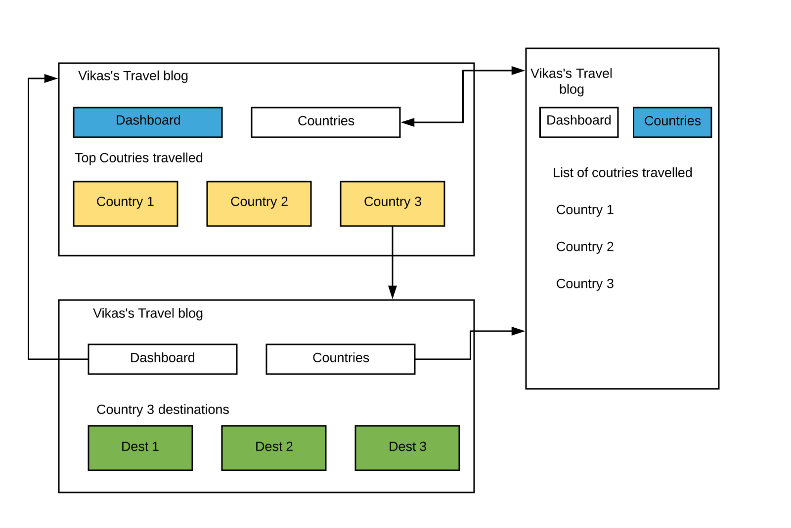
Notes:
Something that needs to grab the viewers attention!!

Slide 5
DEMO!
Notes:
Something that needs to grab the viewers attention!!

Slide 6

Conclusion
Routing
Types in which we can configure routes.
Implemented routes for our app.
Notes:
Like mentioned – best for flowcharts, block diagram, and images in the split-view of course!

Slide 7
Next Video
Http interations in Angular.
Notes:
[Mandatory Slide]
Here the name of the next video needs to be mentioned. The narration as you guessed it would be just letting the viewer know exactly where we are at and what we’d be taking over next! ☺

